Slide 1
CSE 110
Aminul Huq
aminul.huq@bracu.ac.bd

Slide 2
Please join google classroom using the following code
ny5pixr

Slide 3
Loops
Suppose that you need to print a string (e.g., "Welcome to Java!") a hundred times. It would be tedious to have to write the following statement a hundred times.
So what we can do is that we can use Loops
Three types of loops are available in Java
While
Do while
for

Slide 4
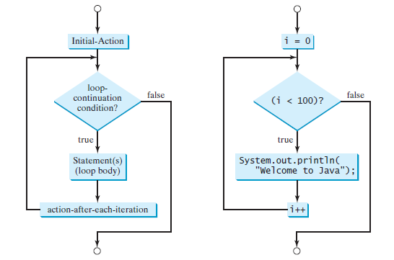
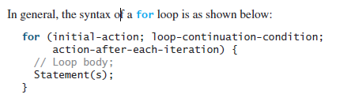
for loop
Syntax & flow-chart

Slide 5
While
The condition can be any Boolean expression. The body of the loop will be executed as long as the conditional expression is true. When condition becomes false, control passes to the next line of code immediately following the loop. The curly braces are unnecessary if only a single statement is being repeated.
The syntax for the while loop is as follows:
while (loop-continuation-condition) {
// Loop body
Statement(s);
}

Slide 6
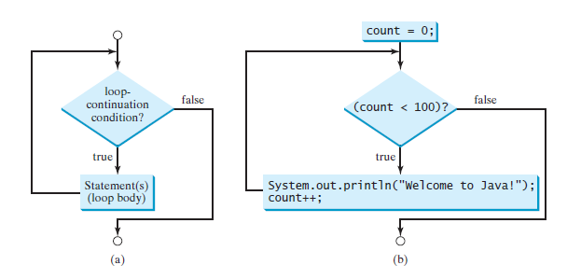

Example

Slide 7
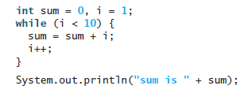

What is the output of the following programs and how many times this loop will repeat ?

Slide 8
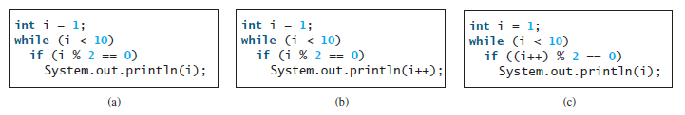
What is the output of the following programs and how many times this loop will repeat ?

Slide 9
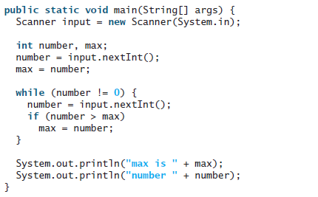
Suppose the input is 2 3 4 5 0. What is the output of the following code?

Slide 10
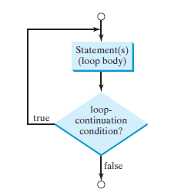

do-while loop
Syntax 7 flow chart

Slide 11
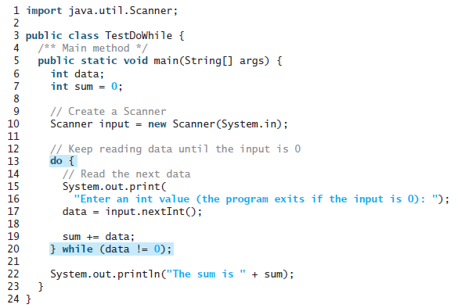
Example

Slide 12

Infinite Loops
If the loop-continuation-condition in a for loop is omitted, it is implicitly true. Thus the statement given below becomes an infinite loop

Slide 13
Tasks
Draw a flow chart that reads 5 numbers from the user and displays it.
Draw a flow chart that reads 5 numbers from the user and prints the sum and average.
Draw a flow chart that prints the following sequences
0,5,10,15,20
9,18,27,36,45
-18, -12, -6,0,6,12
-5,10,-15,20,-25

Slide 14
Nested Loops

Slide 15
Tracing
public class Q2B {
public static void main(String[] args) {
int a=54,b=24,d=0;
while (a%2==0 && b%2==0) {
System.out.println(a);
b /= 2;
++d;
}
while (a!=b) {
if (a%2==0) {
a /= 2;
} else if (b%2==0) {
b /= 2;
} else if (a > b) {
a = (a - b)/2;
} else {
b = (b - a)/2;
}
System.out.println(a);
System.out.println(b);
}
System.out.println(a+b+d);
}
}
54 54 54 27 3 12 3 6 3 3 3 9

Slide 16
public class Q2B {
public static void main(String[] args) {
int n=2003;
int reverse=0;
while (n>0)
{
reverse=reverse*10+n%10;
n/=10;
if (reverse > n)
{
System.out.println(n*reverse);
}
if (reverse < n)
{
System.out.println(n+reverse);
}
else if (n > 10)
{
System.out.println(n-reverse);
}
}
System.out.println(reverse);
System.out.println(n != reverse);
System.out.println("n="+n+reverse);
System.out.println(reverse/10000);
double floatingPointValue = reverse/1000;
System.out.println(floatingPointValue);
}
}
203 600 -10 600 0 3002 true n=03002 0 3.0

Slide 17
public class Q2A
{
public static void main(String[] args)
{
int x = 1, y = 0, sum = 0;
while (x < 10){
y = 40;
while (y > 22){
if ((sum > 20) && (sum < 60))
{
sum += x * 3;
}
else
{
sum += 23;
}
if ((sum > 40) && (sum < 100))
{
sum += x * 2;
}
System.out.println(sum+x);
y -= 10;
}
x += 2;
}
}
}
24 27 38 53 80 113 138 161 186 209

